Slide 1




sales demand forecasting
DATA FROM : YEAR ( 2013-2017)

Slide 2





Dataset Overview
Chromium One
Vast Shadow
Data taken from kaggle
Analyzed data in jupyter notebook
Historical sales dataset (2013–2017 actual sales).
Forecast data generated for 2018.
No. of Years : 5 (2013-2017)
No. of Stores : 10
No. of Items : 50
Columns:
date → daily sales timeline
item → product/item identifier
store → store identifier
sales → daily sales values

Slide 3
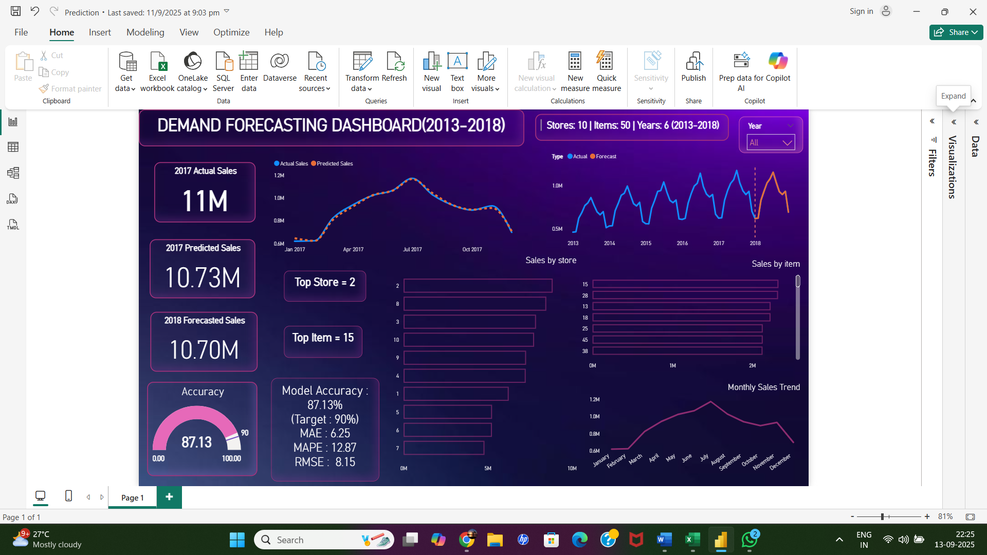
3

Slide 4


03
Business Problem
Difficulty in accurately forecasting
sales demand.
Frequent stock-outs during peak seasons.
Excess inventory in low-demand
periods → increased costs.
Inefficient inventory and resource allocation.
Missed opportunities for revenue growth and customer satisfaction.
Goal
“The goal of this project is to develop a reliable sales forecasting model and dashboard that empowers businesses to make informed, data-driven decisions for inventory and demand planning.”
4

Slide 5

Solution
Used historical sales data to identify patterns and trends.
Apply machine learning forecasting models to predict future sales.
Build an interactive dashboard for store, item, and seasonal insights.
Enable data-driven inventory and resource planning.
Improve overall forecast accuracy, efficiency, and profitability.
5

Slide 6

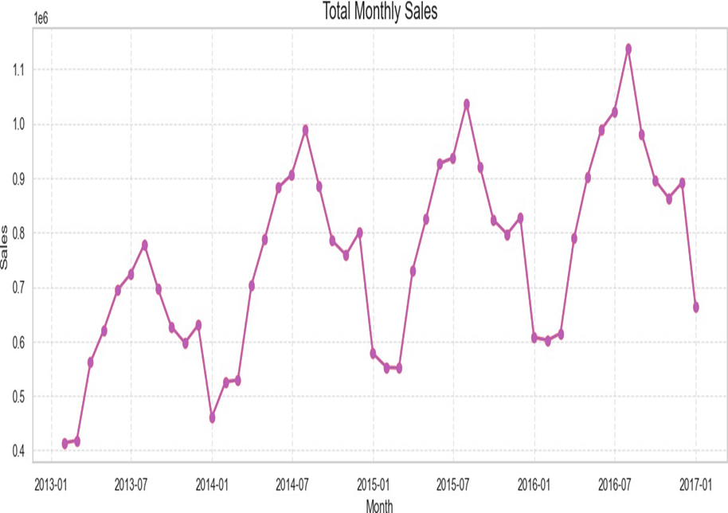
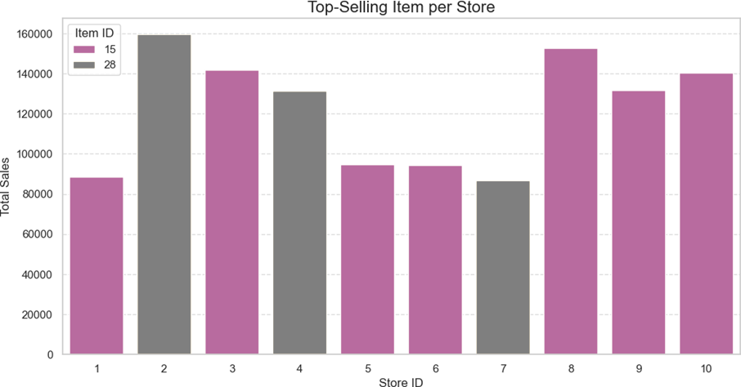
Exploratory Data Analysis
Insights:
Store 2 and Store 8 are performing Best
Item 15 and Item 28 are performing Best.
A few stores and item contribute the majority of sales
Insights:
Strong seasonality with sales peaks in festive/high-demand months.
Noticeable decline in off-season periods.

Slide 7
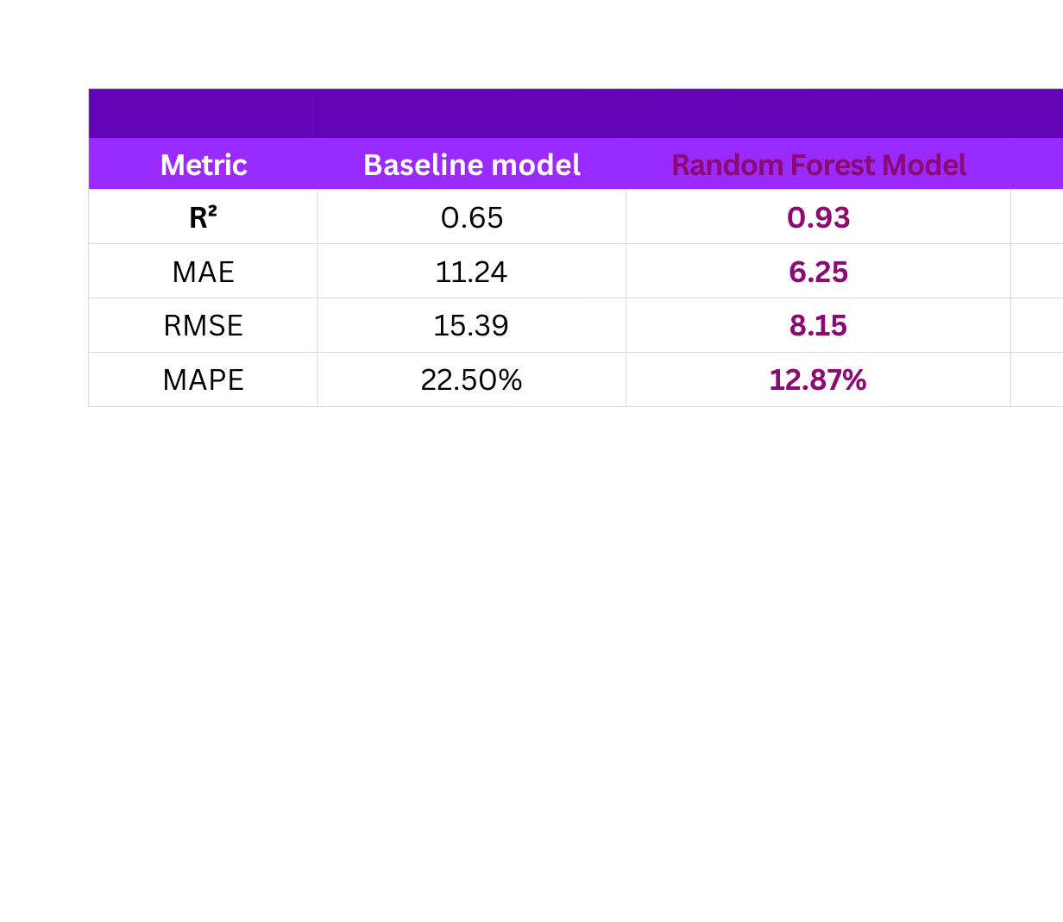
Model Building and Evaluation
Selected Random Forest Regressor as the primary forecasting model.
Trained model using historical sales data (2013–2017).
Compared performance against a baseline model (yesterday’s sales = today’s sales).
“The model is highly accurate and provides actionable forecasts that directly
support business decision-making.”
7

Slide 8
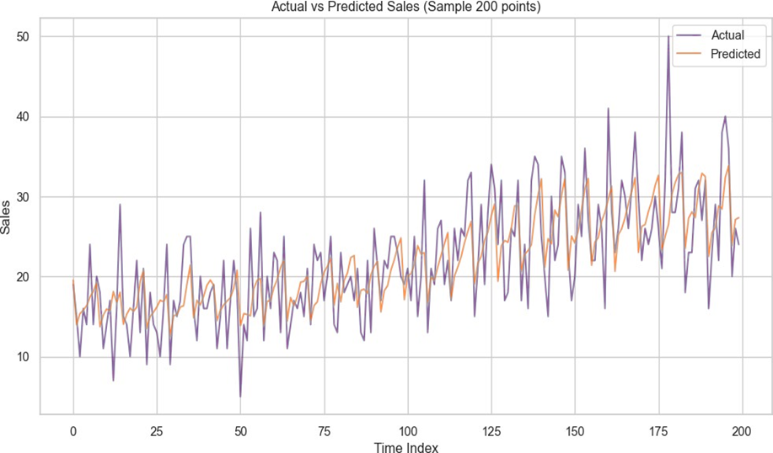
Actual vs Predicted Sales
Predicted sales follow actual sales very closely.
Minor deviations only in sudden demand spikes.
Confirms high model accuracy (R² = 0.93, MAPE = 12.87%).
Provides confidence to use forecasts for operational planning.
“The model’s predictions align strongly with real sales, making it reliable for business decision-making.”
8

Slide 9
📦 Inventory Optimization → Reduce stock-outs and excess stock.
🛒 Product Strategy → Focus on top-selling items, reconsider low-demand products.
🏬 Store Efficiency → Invest in high-performing stores, redesign underperforming ones.
📊 Better Decision-Making → Reliable forecasts for budgeting and staffing.
💰 Profitability Growth → Data-driven actions lead to higher sales & lower costs.
“Turning data into foresight → enabling smarter, faster, and profitable business decisions.”
Overall Business
value

Slide 10
THANKYOU
“Turning data into foresight → enabling smarter,
faster, and profitable business decisions.”
10

